Slide 1
Heterogeneity of Demographic and Risk Strata Across the UNAIDS 90-90-90 Targets in Sub-Saharan Africa – A Systematic Review
July 23rd, 2018

Slide 2
Do the Virally Suppressed Differ from the Unsuppressed?
Achievement of the 90-90-90 targets will still leave 27% of people living with HIV virally unsuppressed
Objective: systematically review and summarize literature assessing heterogeneity of demographic and risk strata across the 90-90-90 cascade
Risk heterogeneity could lead to higher incidence

Slide 3
Systematic Review Methods
Population
Adults 15+,
sub-Saharan Africa,
Living with HIV-1
Exposures
Demographic strata,
Sexual risk behavior
Outcomes
Awareness of status,
ART use,
Viral suppression among ART users,
Viral suppression among all living with HIV
Other Criteria
2014 onwards
2,156 Titles Screened
849 Excluded
880 Excluded
1,276 Abstracts Screened
694 Excluded
582 Full Text Review
536 Excluded
Grey Literature Included
PHIA Results = 7
53 Sources Abstracted

Slide 4
Which 90 Measures Are Reported On?
Majority of studies define viral suppression as <1,000 copies/mL
Other cutoffs include:
<50 (1)
<200 (1)
<400 (3)
<500 (1)
<5,000 (1)
<40 in plasma, <550 in DBS (1)

Slide 5
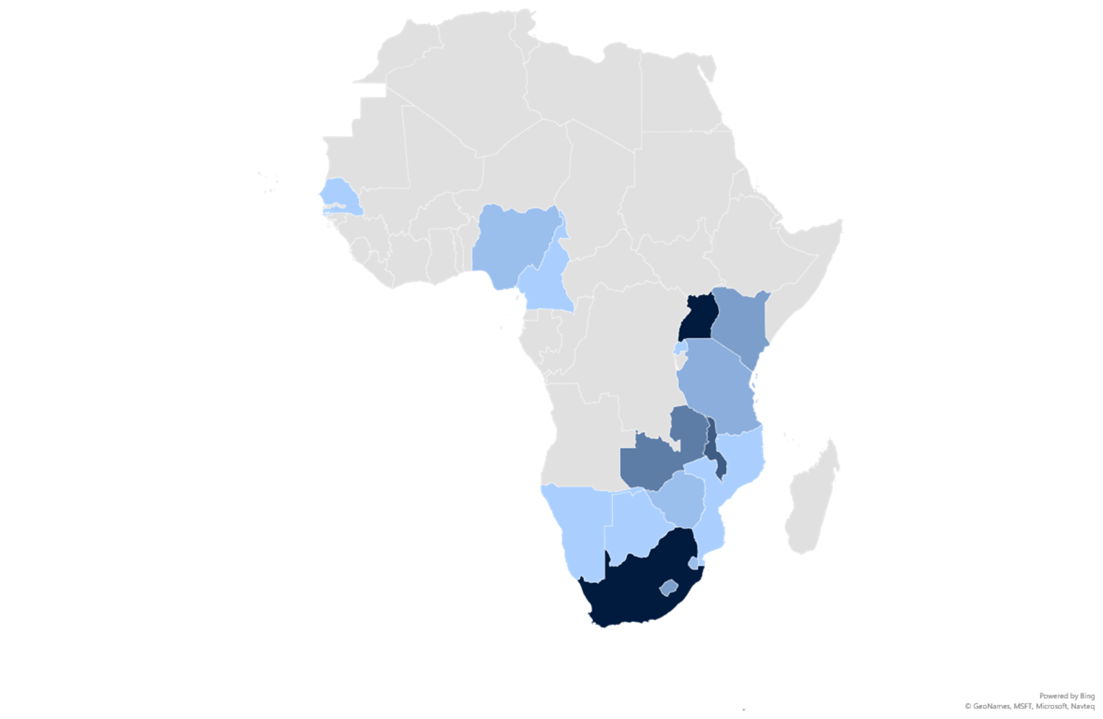
17 Countries Represented in Review
Country | Number of Studies
Uganda | 12
South Africa | 12
Malawi | 8
Zambia | 6
Kenya | 4
Lesotho | 4
Tanzania | 3
Nigeria | 2
Swaziland | 2
Zimbabwe | 2
Botswana | 1
Rwanda | 1
Cameroon | 1
Mozambique | 1
Kenya | 1
Namibia | 1
Senegal | 1
# Studies

Slide 6
Diverse Study Designs and Sampling Methods

Slide 7
More Potential for Assessment of Risk-Heterogeneity
No studies reported a 90 measure disaggregated by sexual risk behavior

Slide 8
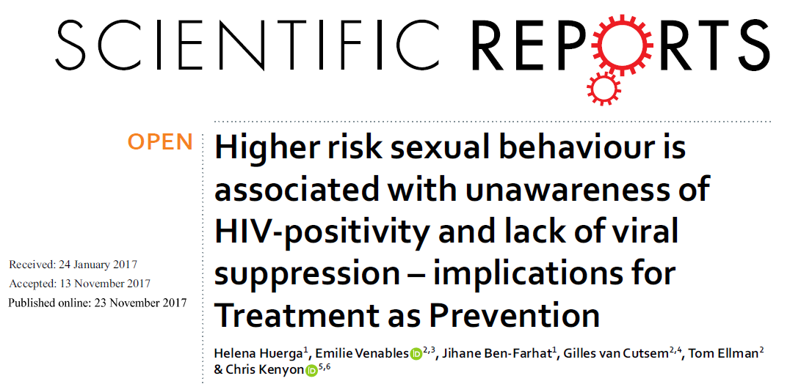

Slide 9
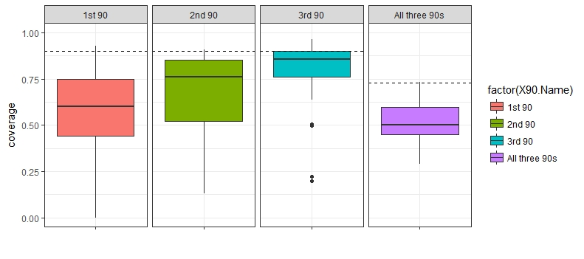
Substantial Variation in Study Estimates
90 Measure

Slide 10
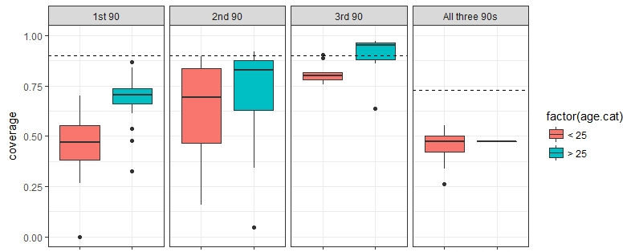
90-90-90 by Age
Age

Slide 11
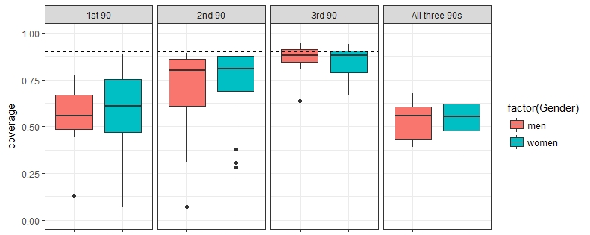
90-90-90 by Gender
Gender

Slide 12
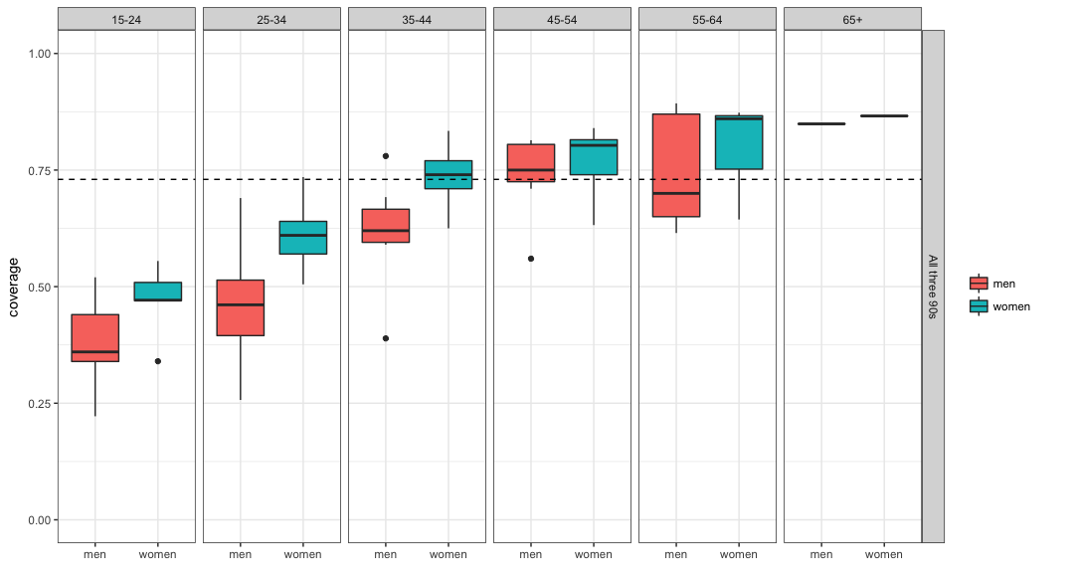
PHIA Viral Suppression by Age and Gender
15-24
25-34
35-44
45-54
55-64
65+
Gender

Slide 13
Are Mobile Populations Less Likely to be Suppressed?
Study | Country(s) | Mobility Definition | Ref. Group | Assoc. with Viral Suppression
SEARCH | Kenya, Uganda | >1 mo. away | <1 mo. away | RD: -2.6% (n.s.)
HIPSS | South Africa | >1 mo. away | <1 mo. away | OR: 0.77 (n.s.)
BCPP | Botswana | >3 mo. away | No time away | PR: 0.78
Limited published assessment, and mixed results for association of mobility with viral suppression
Unbiased measure of association inherently challenging, even in population-based studies
True effect and magnitude of mobility may differ by setting

Slide 14
Heterogeneity by Employment in Kenya & Uganda
Similar suppression among employed and unemployed
Are employment categories useful for assessing viral suppression?
Ex. “Other”
Need for assessment by gender and age?

Slide 15
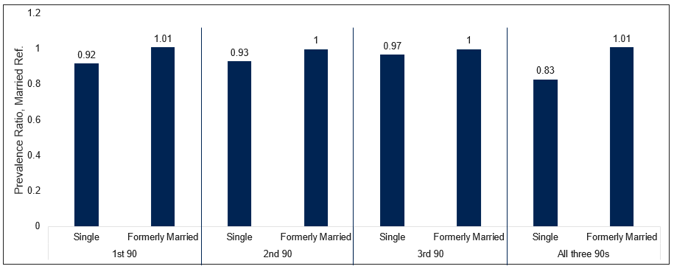
Heterogeneity and Relationship Status in Botswana
Single persons may have lower prevalence of 90 achievement
Gender and age likely critical for stratified analysis

Slide 16
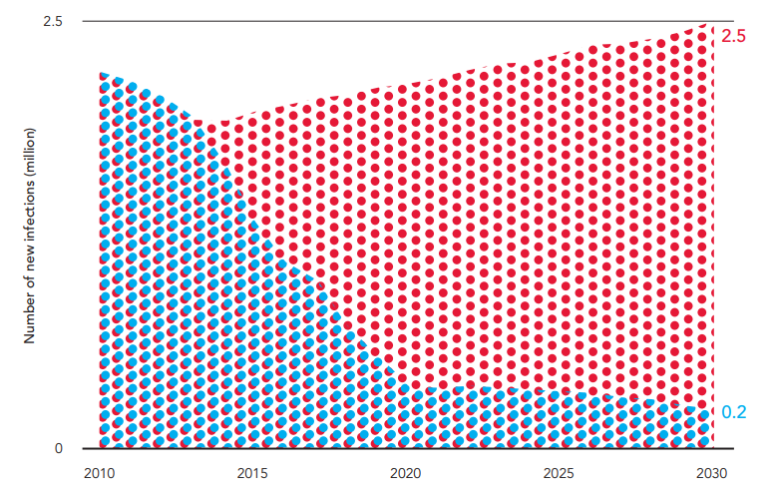
Understanding Risk-Heterogeneity of 90-90-90 is Critical
Suggestion of age and sex heterogeneity
Other demographic strata are more complex
Much more to be learned especially by risk behavior
Profile of the unsuppressed has programme, policy, and planning implications

Slide 17
Acknowledgements
Brenda Kharono
Diana Tordoff
Paul Drain
Ann Duerr
Adam Akullian
Anna Bershteyn
Michelle Morrison
Geoff Garnett

Slide 18
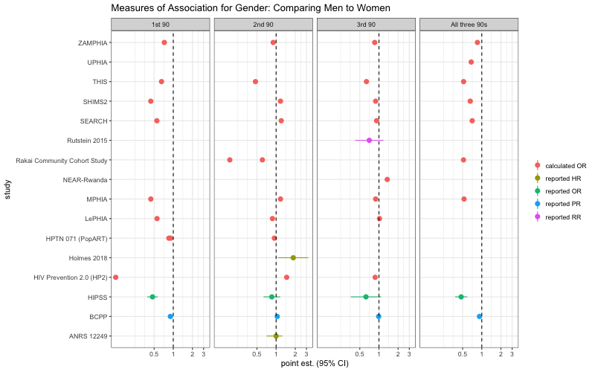
Association of Male Gender on Each 90 Measure

Slide 19
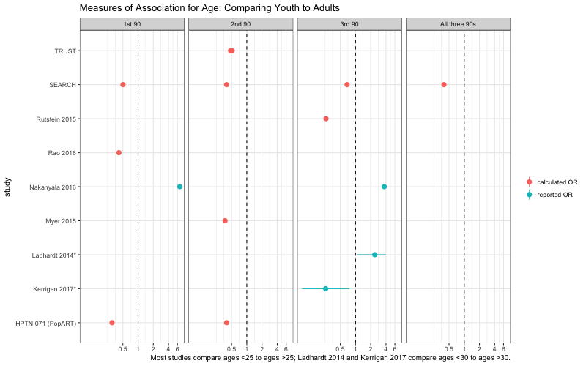
Association of Age <25 on Each 90 Measure

Slide 20
Education

Slide 21
Income

